Slide 1

Cepstral Analysis GUI Application - final presentation
Akademia Górniczo-Hutnicza im. Stanisława Staszica w Krakowie
AGH University of Krakow
Bartłomiej Jargut

Slide 2
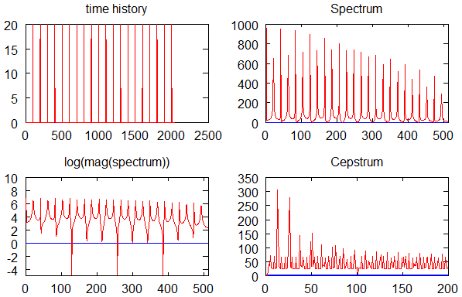
Introduction

Slide 3
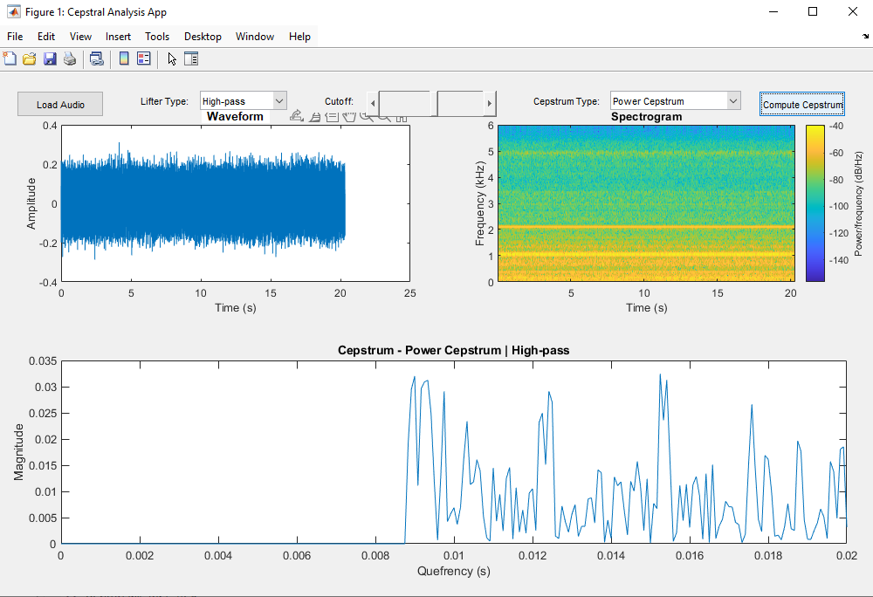
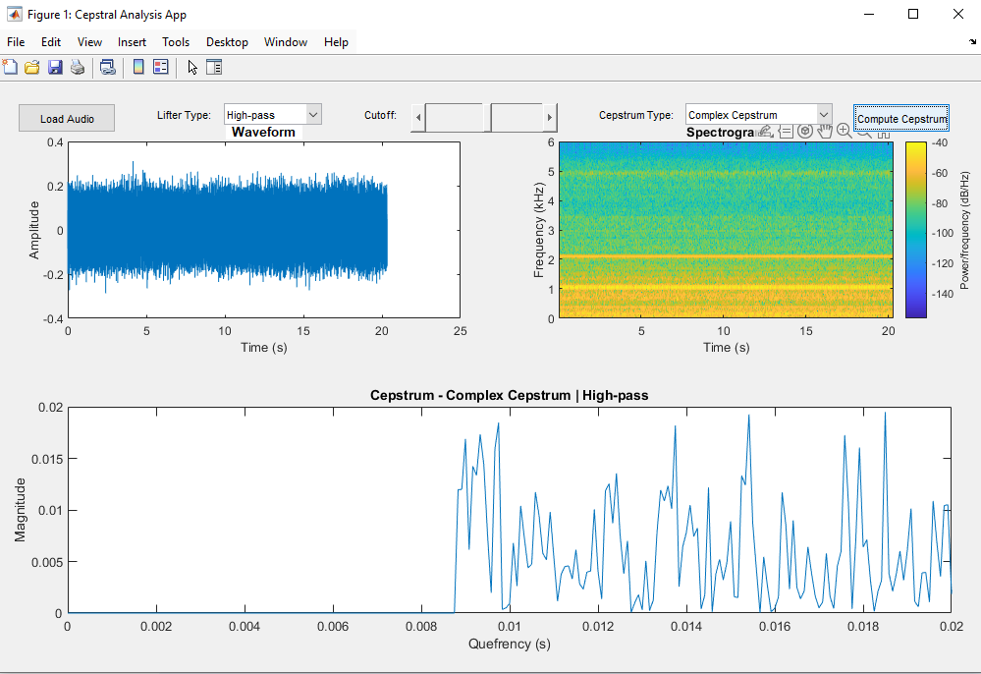
Introduction

Slide 4
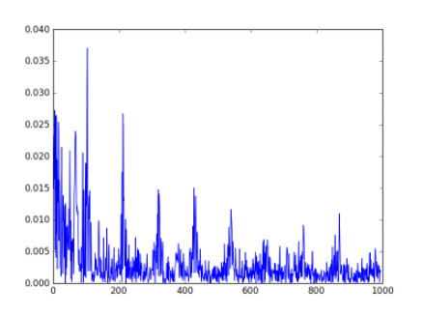
Example 1: Human speech analysis
Cepstrum allows us to separate pitch (source) from formants (vocal tract)

Slide 5
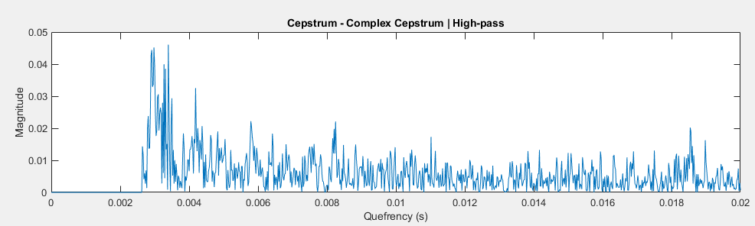
Example 1: Human speech analysis

Slide 6
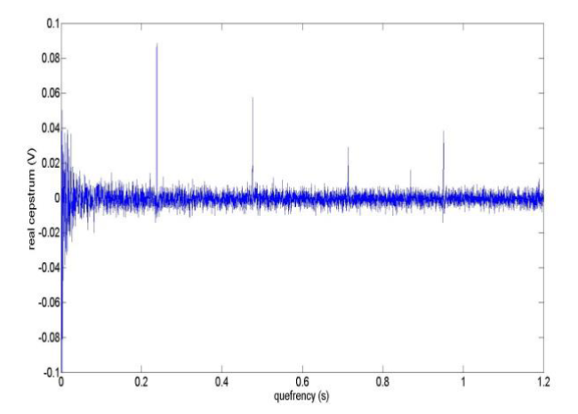
Example 2: Gearbox defect detection
https://www.researchgate.net/figure/The-cepstrum-of-vibration-signal-for-a-faulty-gearbox_fig6_304997040

Slide 7
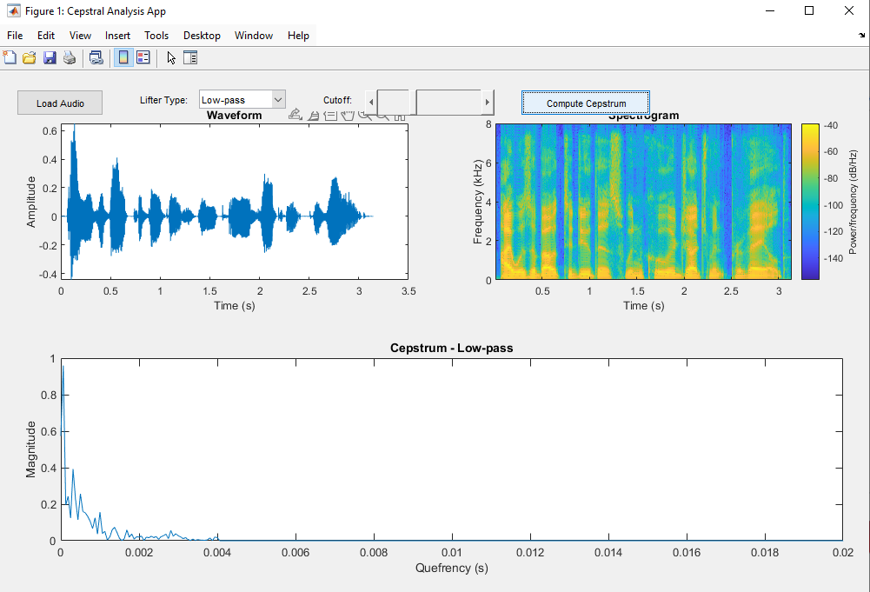
Application layout

Slide 8
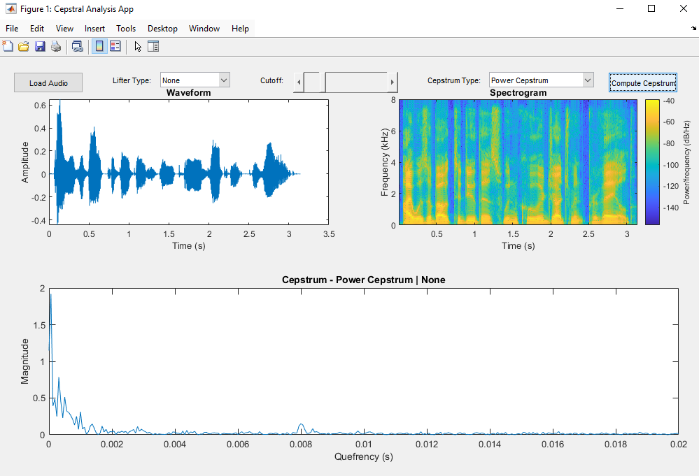
Testing 1: Human speech (no reverb)

Slide 9
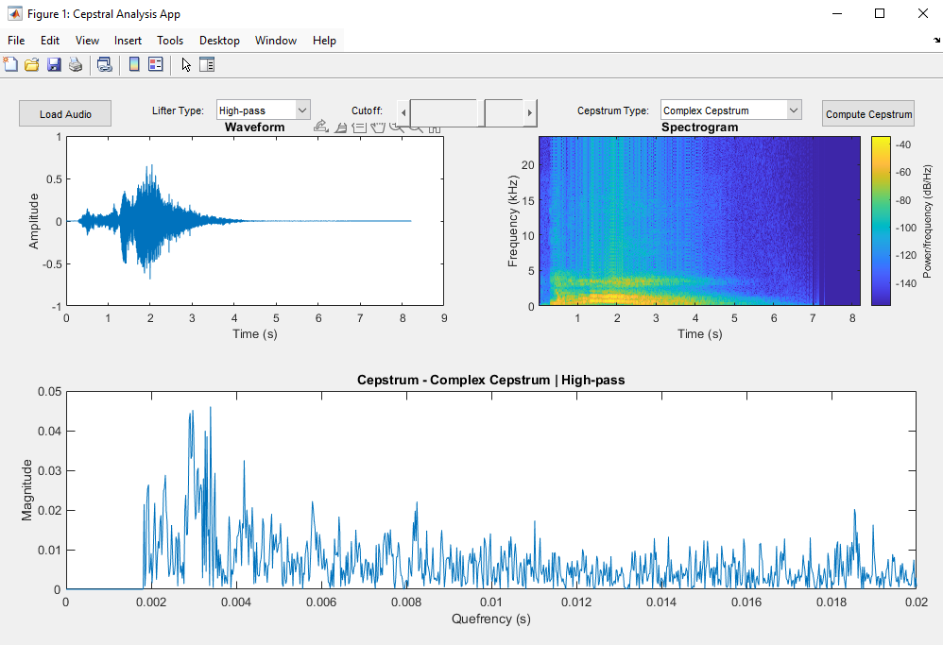
Testing 2: Human voice with reverb

Slide 10
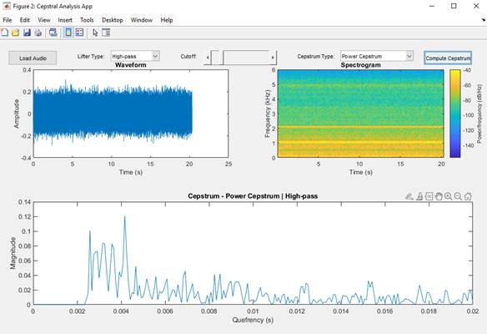
Testing 3: Gearbox fault detection

Slide 11
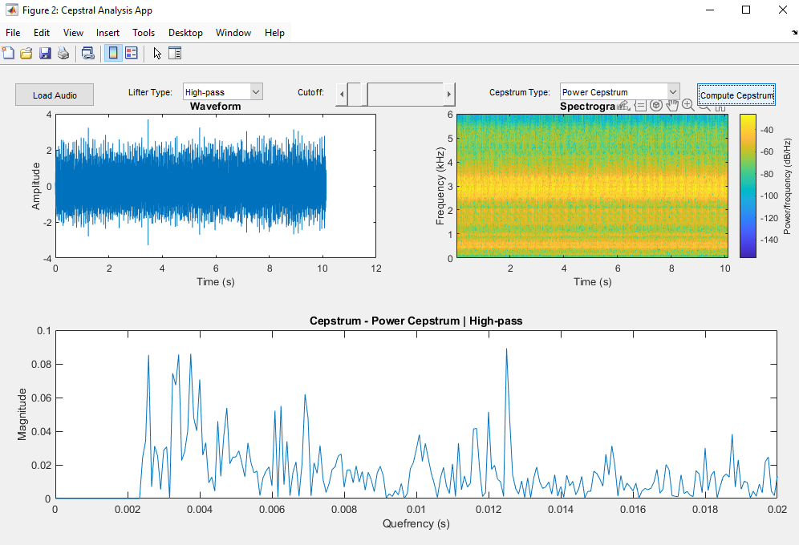
Testing 3: Gearbox fault detection

Slide 12
Thank you for your attention

